Slide 1
Impacts of Climate on Crop Economics and Farmers in Cocoa Producing Countries
February 16th, 2022

Slide 2



PROJECT RESEARCH GOALS
ECONOMY
COCOA PRODUCTION
COCOA FARMERS
Research Hypothesis: As temperatures in top cocoa producing countries increases, their cocoa production yield is negatively impacted.
What is the impact of climate change on the economies of cocoa-producing countries?
What is the impact of climate change on cocoa production?
What is the impact of climate change on cocoa farmers’ farming practices and lifestyle?

Slide 3
TOP COCOA PRODUCING COUNTRIES
Ghana
Côte d'Ivoire
Nigeria
Cameroon
Ecuador

Slide 4
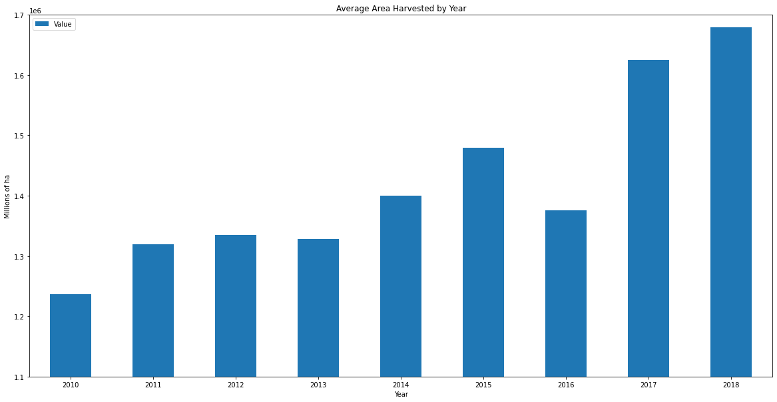
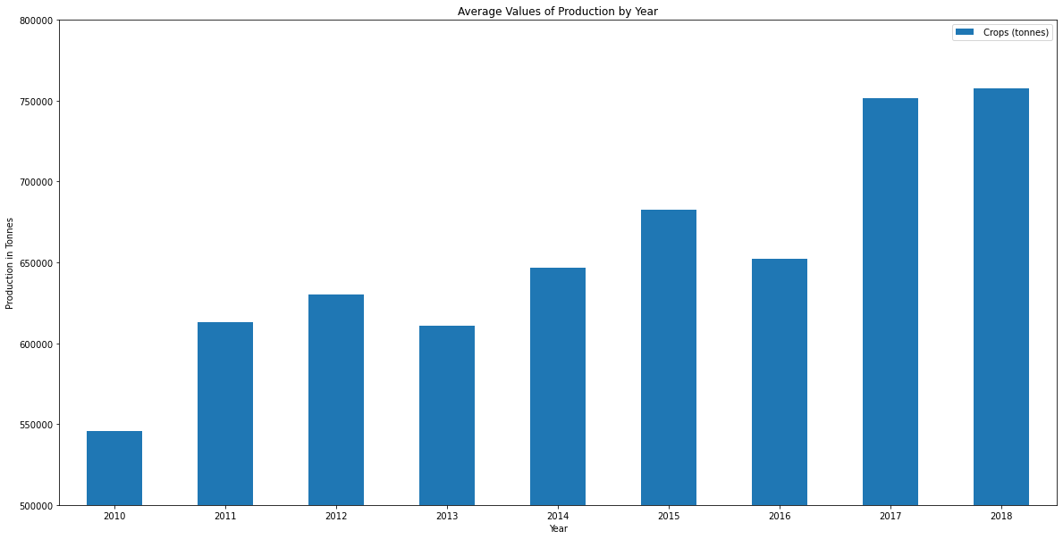
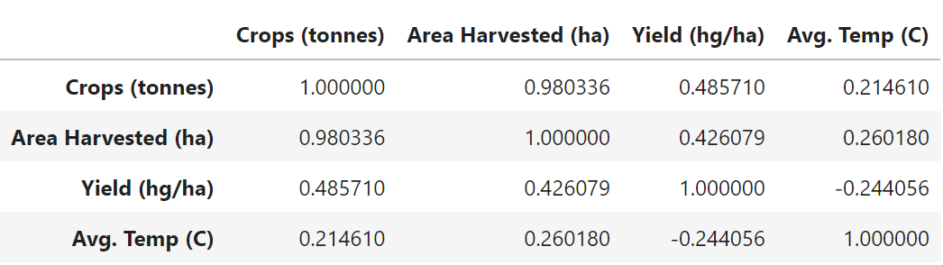
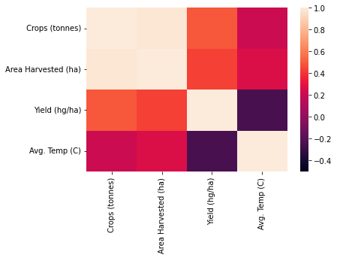
2021 IMPACT ON COCOA PRODUCTION RESEARCH REPORT
Key Findings:
Average temperate and crop production have a medium correlation.
Average temperature and yield have a high negative correlation.

Slide 5
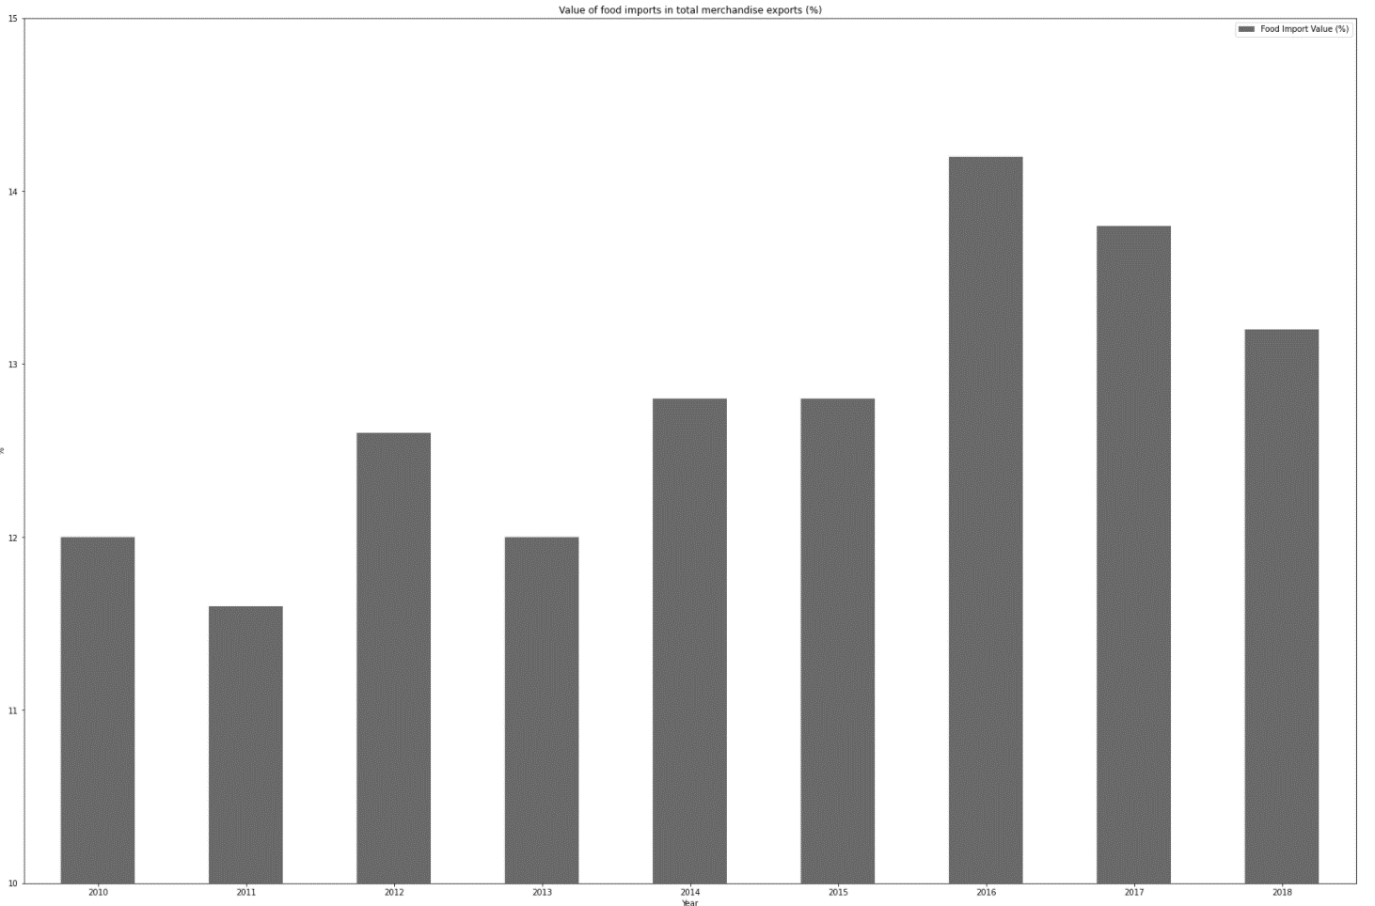
2021 IMPACT ON COCOA ECONOMY RESEARCH REPORT
Raw Material Extraction
Cameroon, Ghana, Côte d'Ivoire, Ecuador, Nigeria
Processing and Manufacturing
Distribution, Marketing, Packaging, Retail Mix
United States, Germany, UK, Netherlands, France
Key Findings:
There is a weak increasing trend in value of food imports over time
Countries want to export more intermediary products and also lower food insecurity

Slide 6
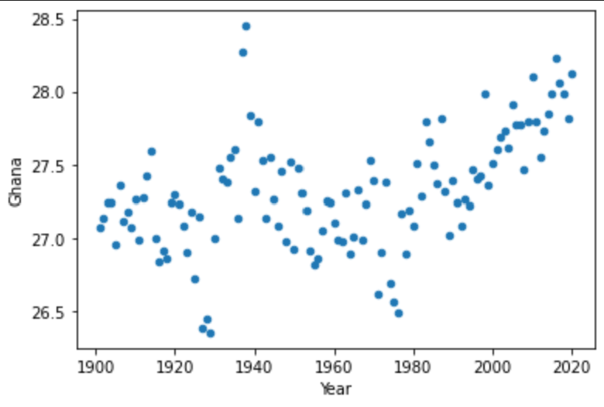
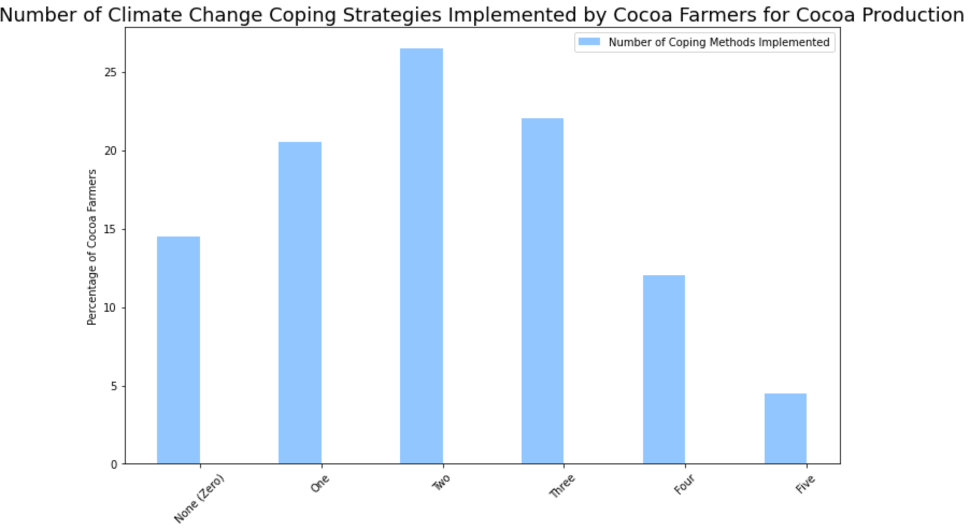
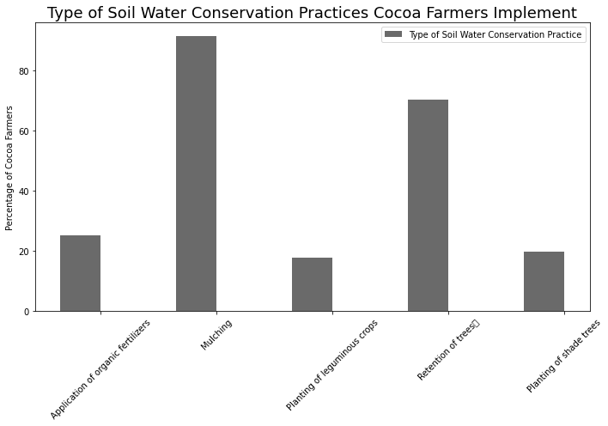
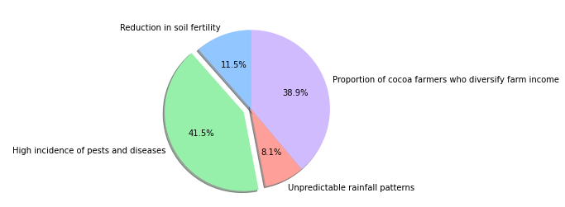
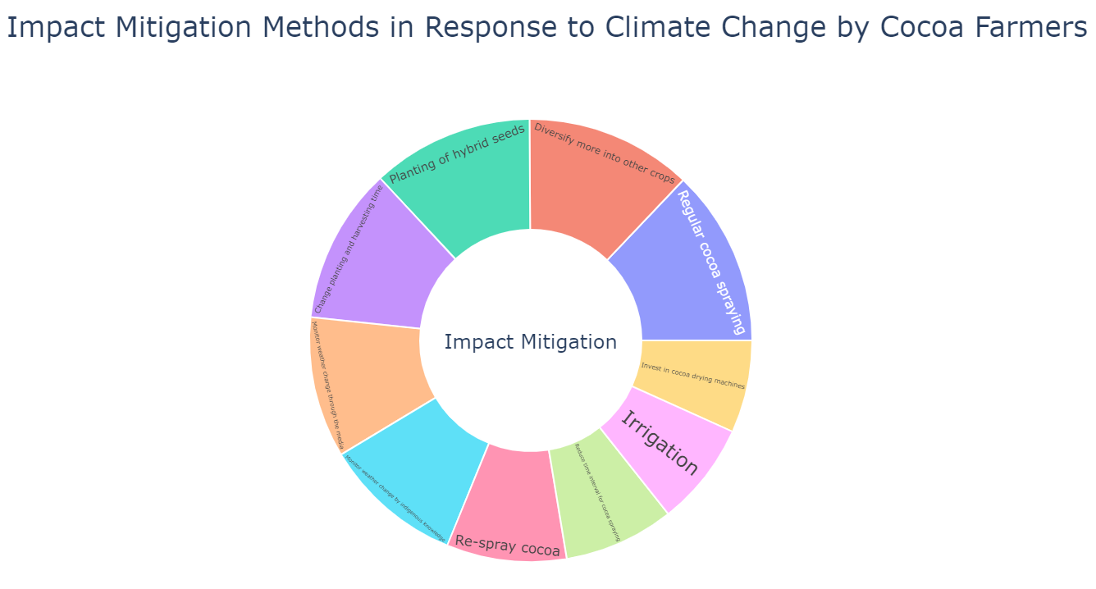
2021 IMPACT ON COCOA FARMERS’ RESEARCH REPORT
Key Findings:
On average, cocoa farmers surveyed implemented two climate change coping strategies
The main negative climate change impacts cited were reduction in soil fertility, high incidence of pests and diseases, unpredictable rainfall patterns and diversifying farm income
Notes:
Survey 1: Dataset on cocoa production and climate change adaptation strategies in Ahafo Ano North District, Ghana
This survey was carried out to understand the perceptions of cocoa farmers on climate change, its impacts on cocoa production and their adaptation methods.
378 cocoa farmers were interviewed from the six area councils and one town council of the Ahafo Ano North District of Ghana. The major objective of the survey was to understand the perceived impacts of climate change on cocoa production and the methods being used by the farmers to adapt.
Key findings were:
Key impact mitigation strategies are: diversifying more into other crops, changing planting and harvesting times and regular cocoa spraying
Key coping methods:
Survey 2: Climate change, soil water conservation, and productivity: Evidence from 400 cocoa farmers in Ghana
OBJECTIVE: Our study focuses on soil water conservation practices carried out by cocoa farmers in Ghana to cope with climate change, its impact on productivity, and the determinants.
Key findings were:
The study found that 97% of cocoa farmers carry out soil water conservation practices as a coping strategy for climate change.
These are application of organic fertilizers, mulching, planting of leguminous crops, retention of trees, and planting of shade trees.
On average, cocoa farmers carry out two of these practices.
Survey 3: Climate change coping and adaptation strategies: How do cocoa farmers in Ghana diversify farm income?
The study focuses on income diversification of cocoa farmers in Ghana as a strategy to cope with climate change. Data was compiled from 400 cocoa farmers
Income diversification is an important strategy of Ghanaian cocoa farmers to cope with climate change.
Diversification strategies include crop and livestock diversification, intercropping, and off-farm economic activities.
On average diversification of income contributes about 18% of cocoa farmers' annual income.

Slide 7
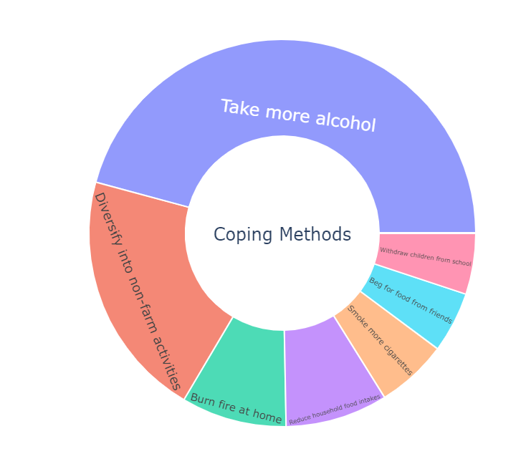
KEY COCOA FARMER FINDINGS
In a 2014 survey conducted with cocoa farmers’ in Ghana, 70% of cocoa farmers’ cited that too much rainfall affects their cocoa production activities and 81% indicated extremely high temperatures affect their cocoa production activities
Top climate mitigation strategies include: diversifying more into other crops, changing planting and harvesting times and regular cocoa spraying
Top soil water conservation practices include: Mulching (91.25% cocoa farmers’ surveyed) and Tree Retention (70.25%)

Slide 8
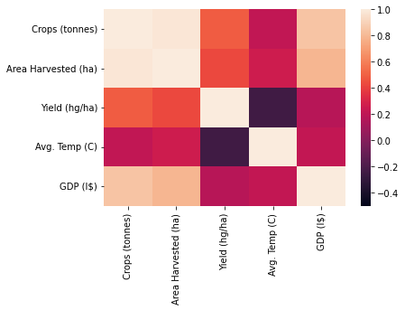
KEY FINDINGS
High correlation between GDP and crop production
As average temperature increases, GDP decreases
As average temperature increases, yield decreases

Slide 9
DATA ANALYSIS
Finding sources that cover key topics
Replacing null values
Data filtering and mapping (e.g. survey data)
Concatenating datasets
Drawing correlations between datasets

